Slide 1
Dynatrace Advance Observability

Slide 2
Key blue print – unbreakable continuous delivery model
Automate operations (self-healing) – auto-mitigate bad deployments in production
Self Healing
Shift right /
Deployment Speed
Automate deployment (shift-right) – push “monitoring-as-code” for auto-validation and auto-alerting
Shift left /
Quality gates
Automate quality (shift-left) – automate the pipeline and stop bad code changes before they reach prod
Multi-platform monitoring
Automate monitoring – use monitoring strategically as feature of the end-to-end pipeline

Slide 3
What we will accomplish
Deploying the SockShop application to our GKE cluster
Setting up Jenkins on K8s in GKE
Import a Jenkins Pipeline
Setup Dynatrace Integration with Jenkins
Using Jenkins Plugin and Monspec
Deploy different code builds and test their performance
Fail pipeline if code is not performant based on monspec
Create a self-healing application using Dynatrace and Ansible Tower

Slide 4


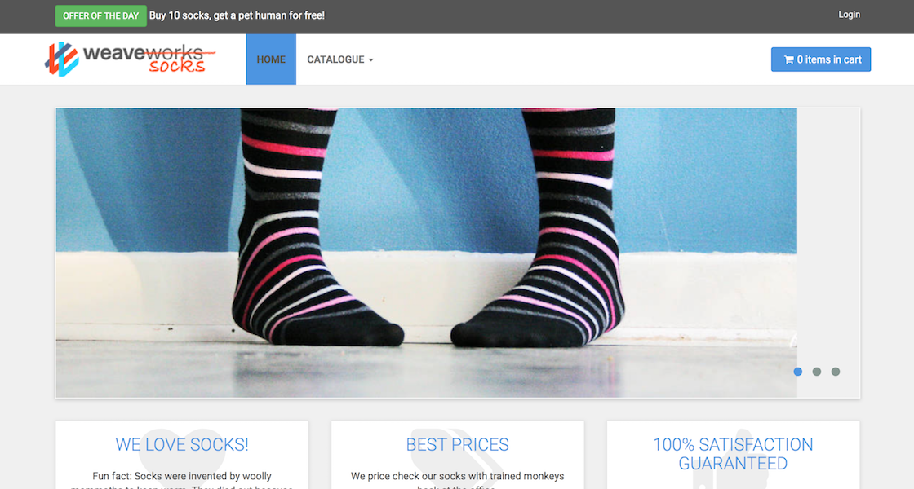


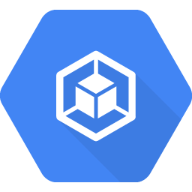
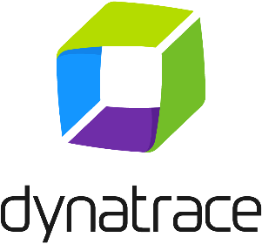


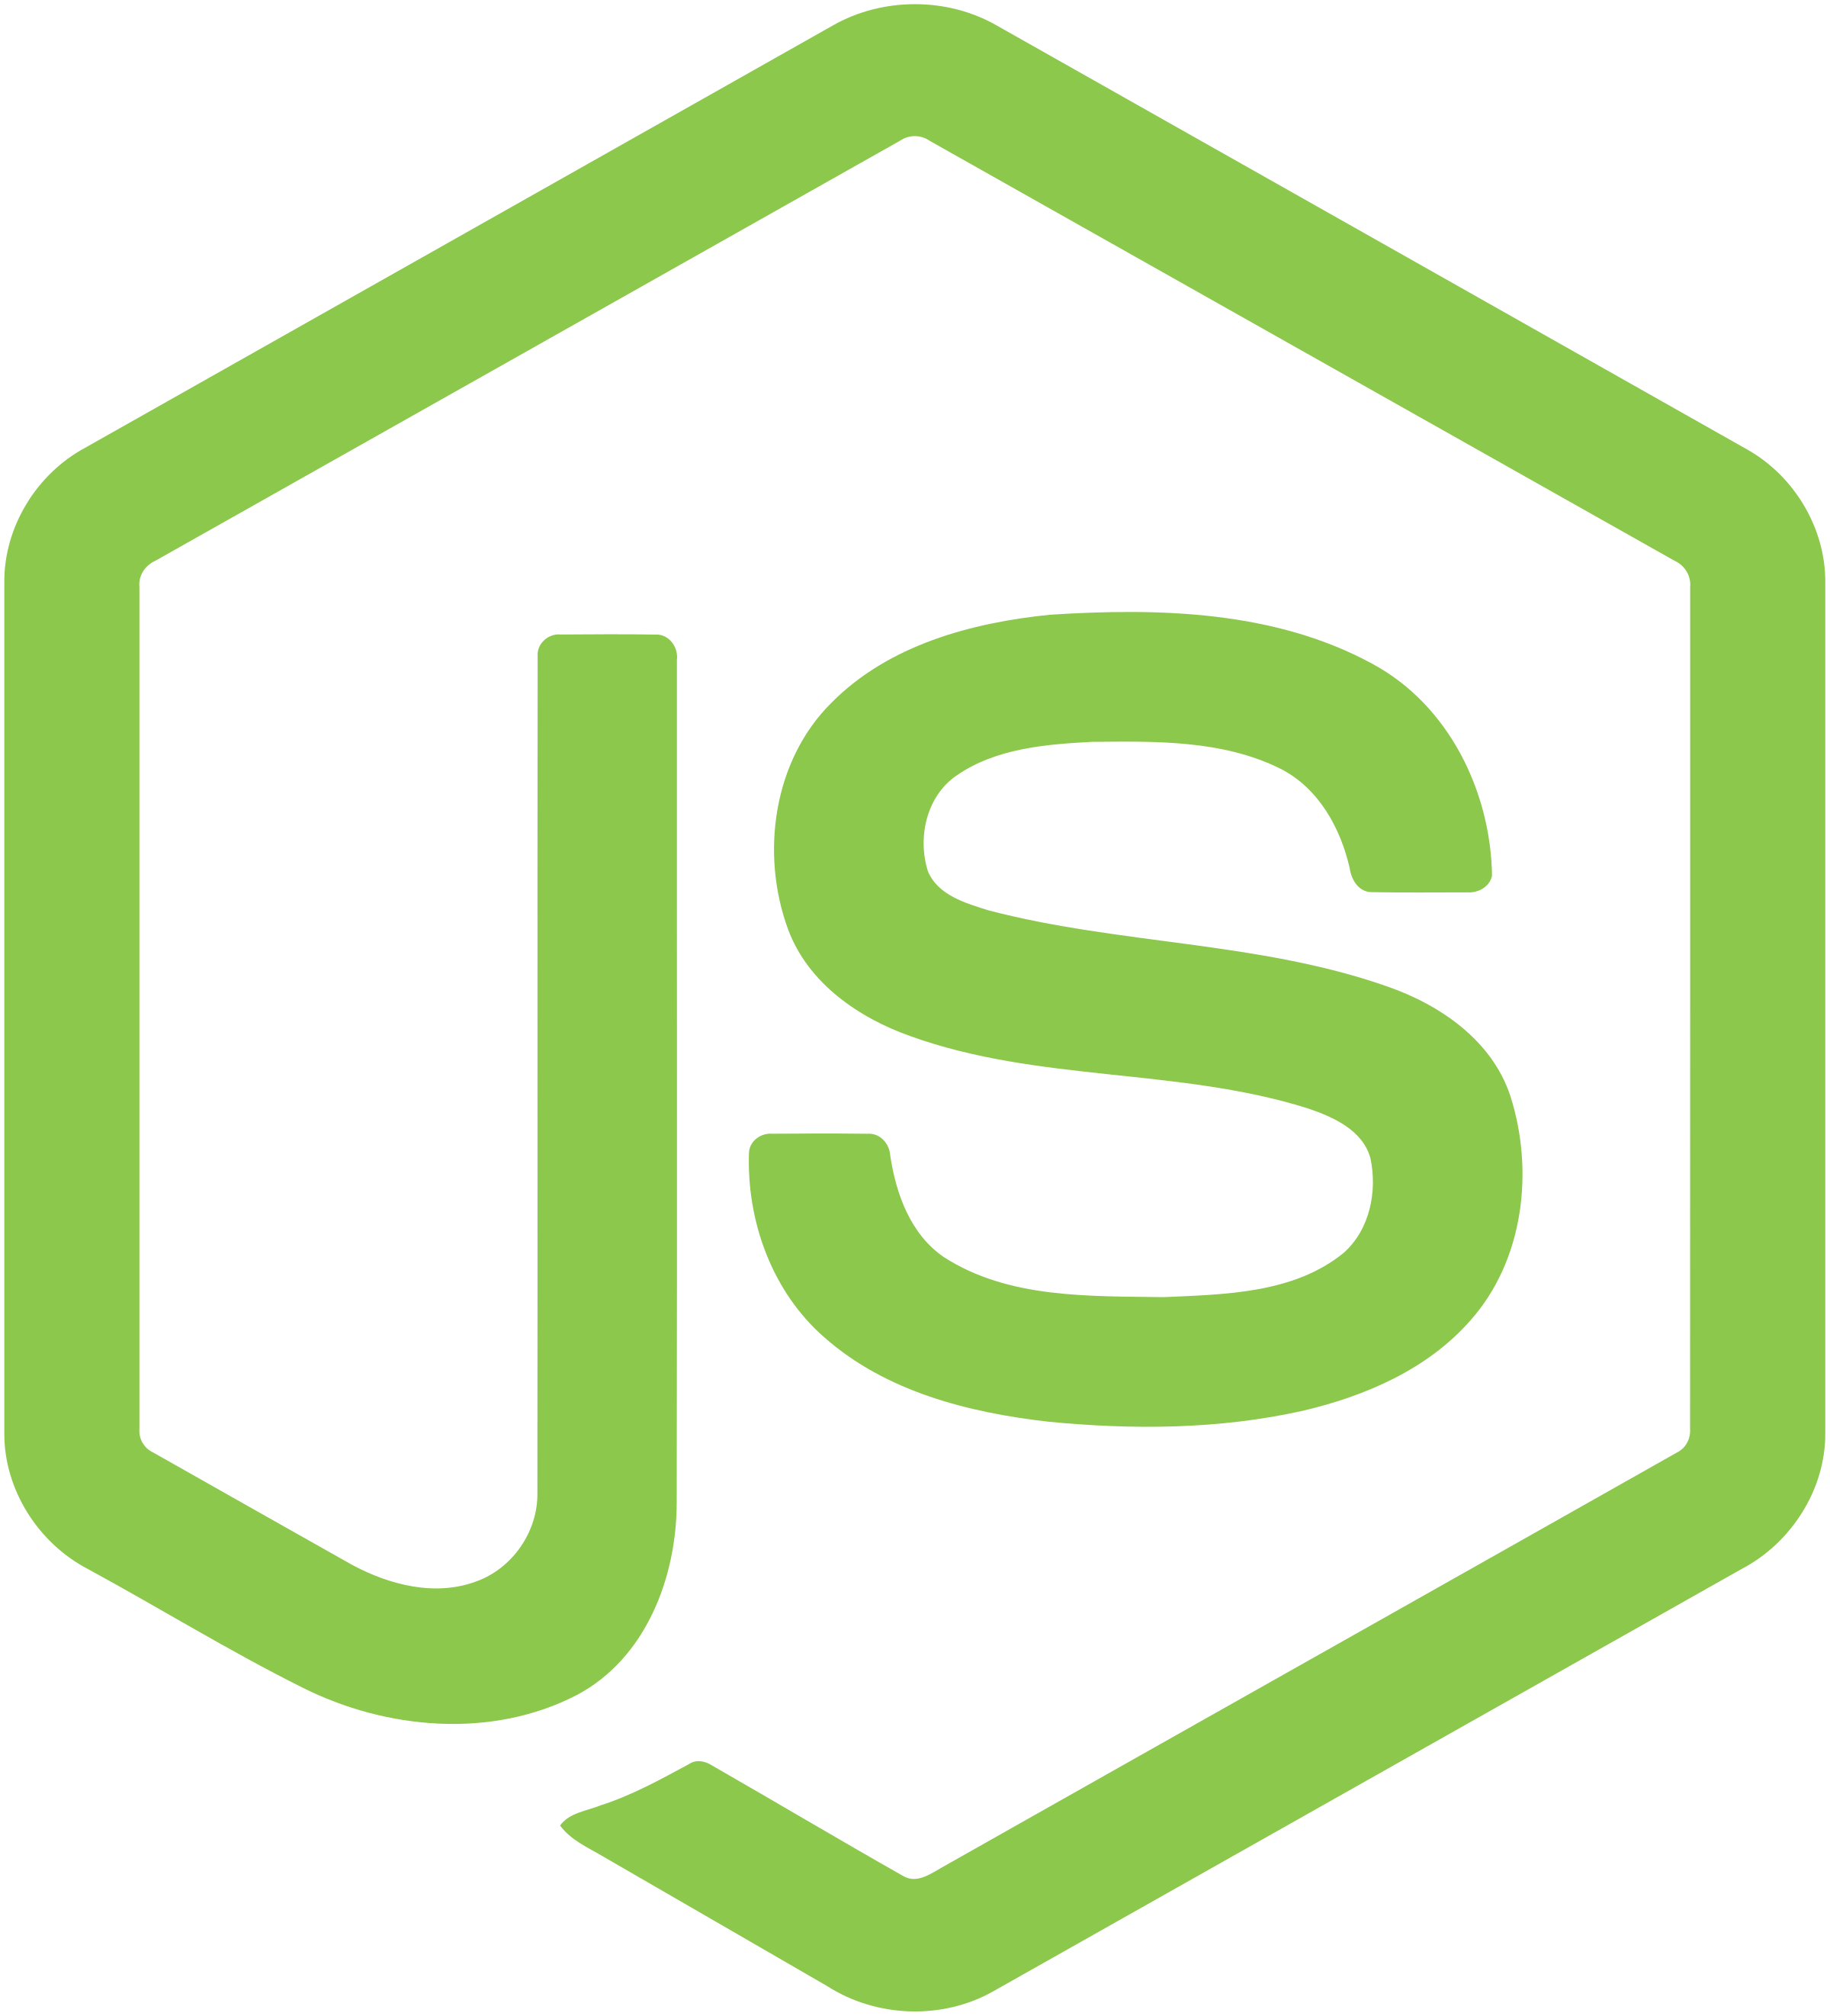

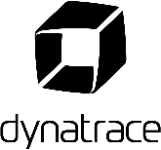

Workshop Setup
SampleApp
GitHub Repository
#2 Download Repo
#1 Create Dynatrace Tenant
#3 Deploy Jenkins
#4 Deploy Ansible Tower
Every Team
On a laptop (or via CloudShell)
K8s
Jenkins
GKE Instances
Ansible Tower

Slide 5
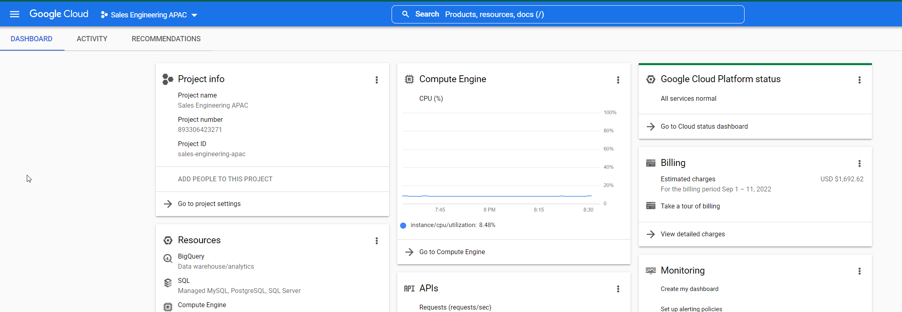
Setting Up GKE Cluster

Slide 6
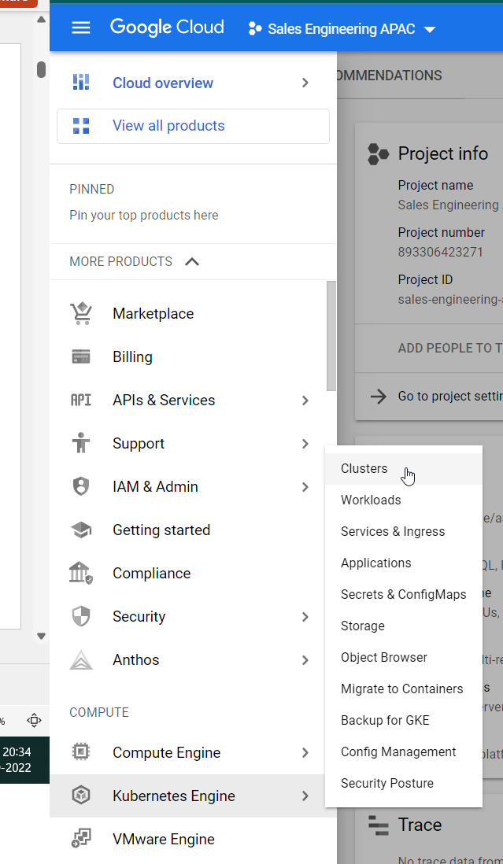
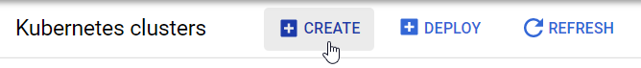
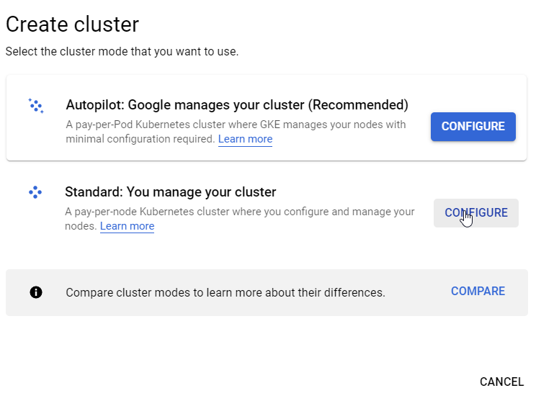
Setting Up GKE Cluster

Slide 7
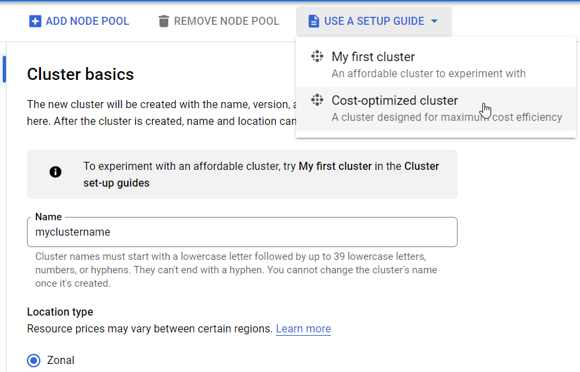
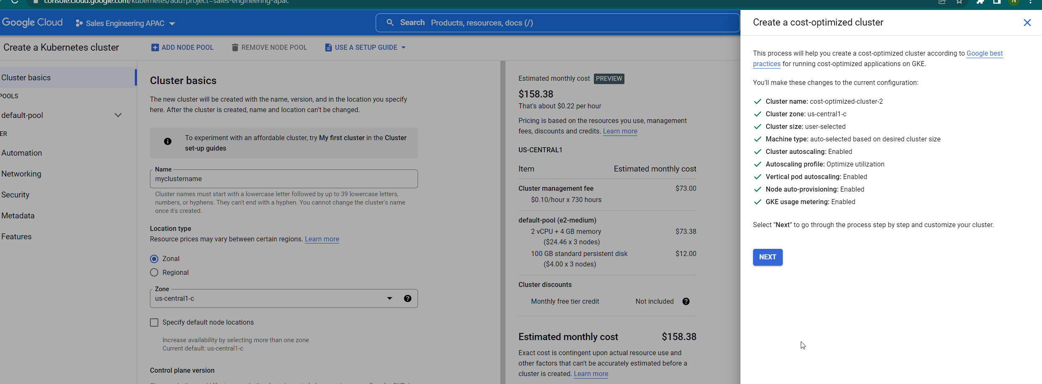
Set Up GKE Cluster
Use cost-optimized cluster
Till Step 3 use default values

Slide 8
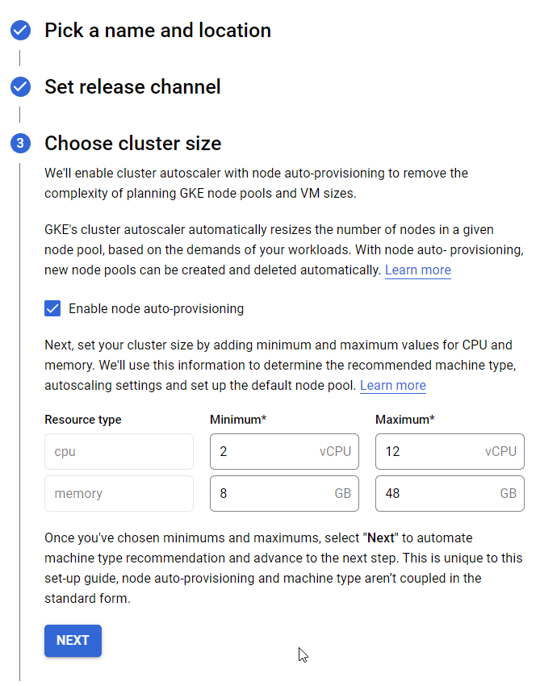
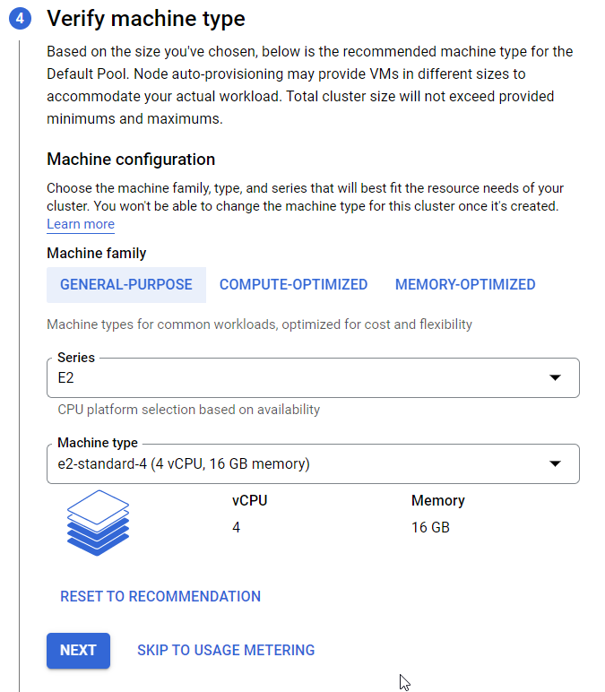
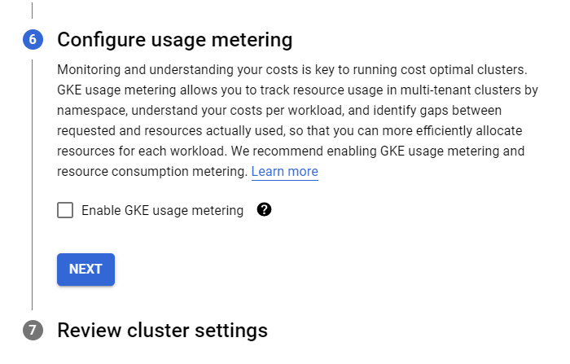
Set Up GKE Cluster
Uncheck the GKE usage
Change value to 12 and 48

Slide 9
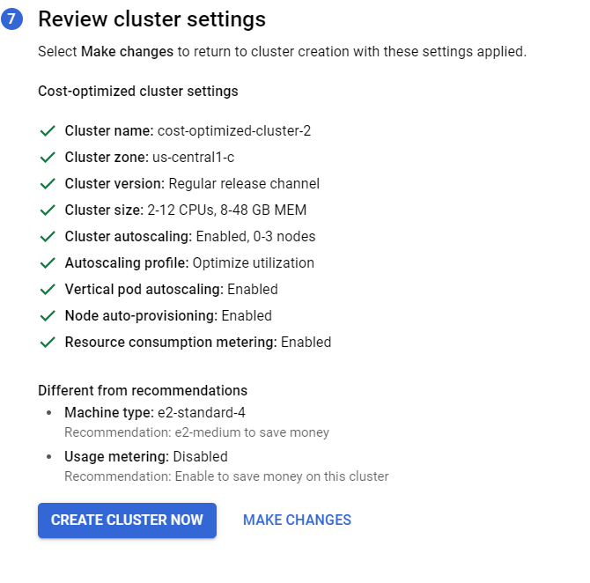
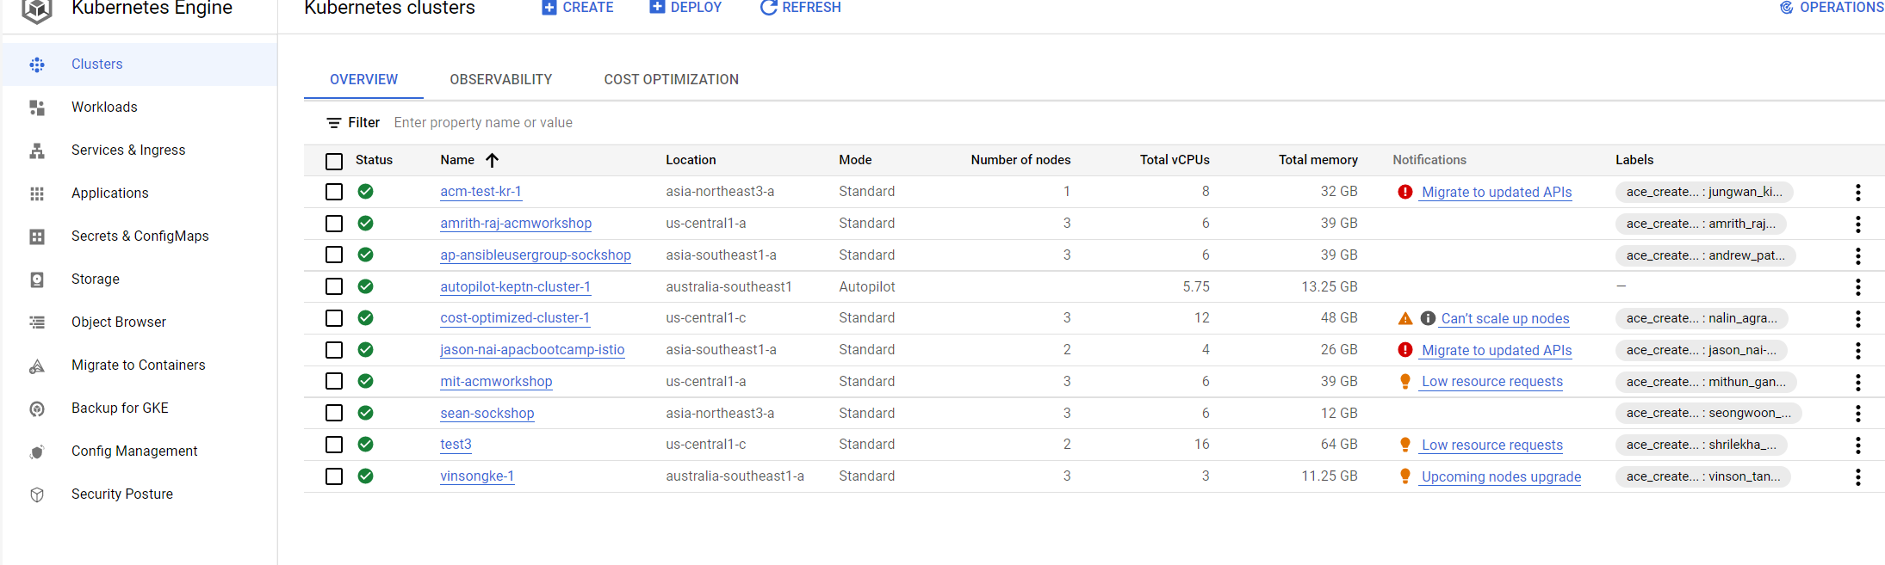
Set Up GKE Cluster
Wait for the status to get create
Create Cluster
This might take 10 minutes to create

Slide 10
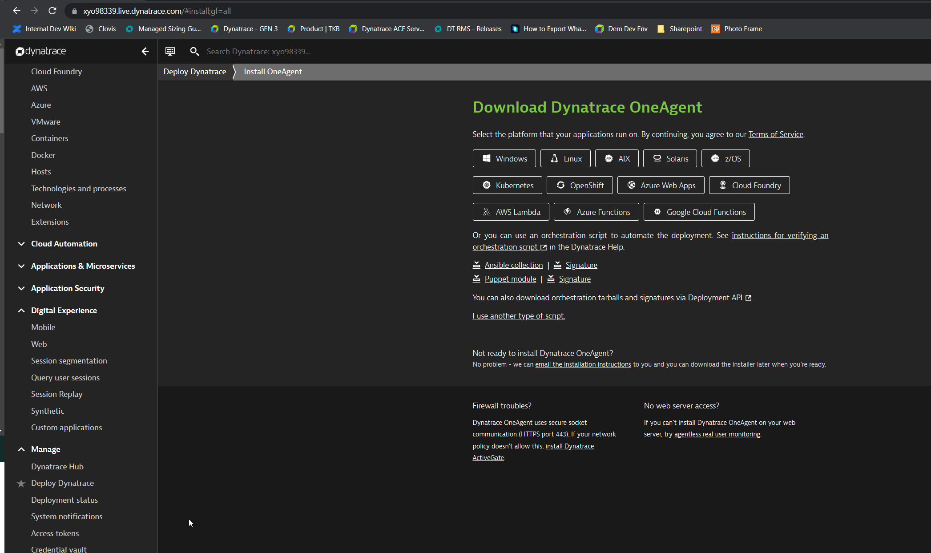
Integrate with Dynatrace

Slide 11
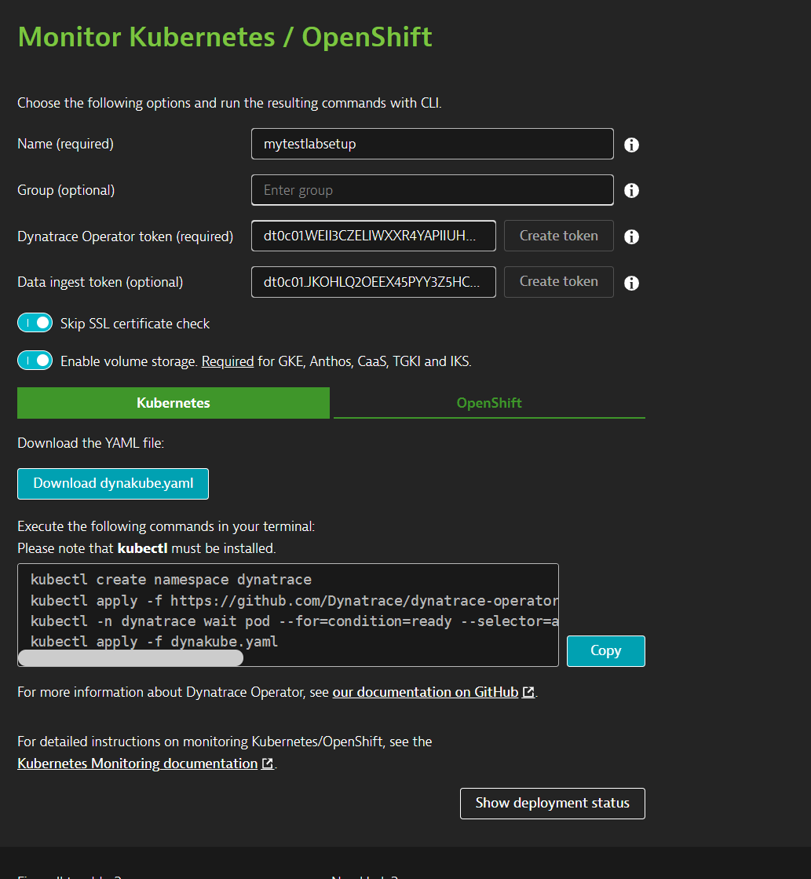
Integrate With Dynatrace
Copy both the tokens and keep them for further use
Download dynakube.yaml
Copy all the command for ease of use

Slide 12
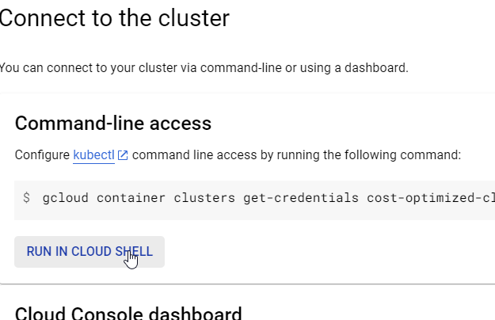
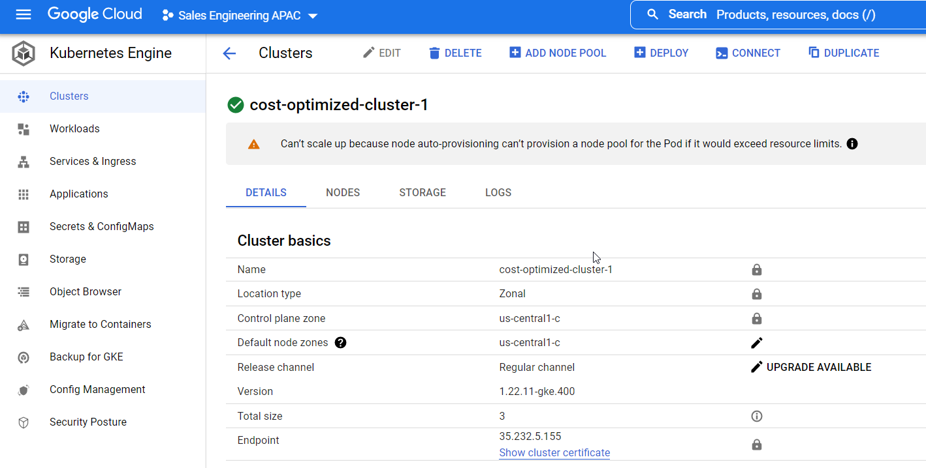
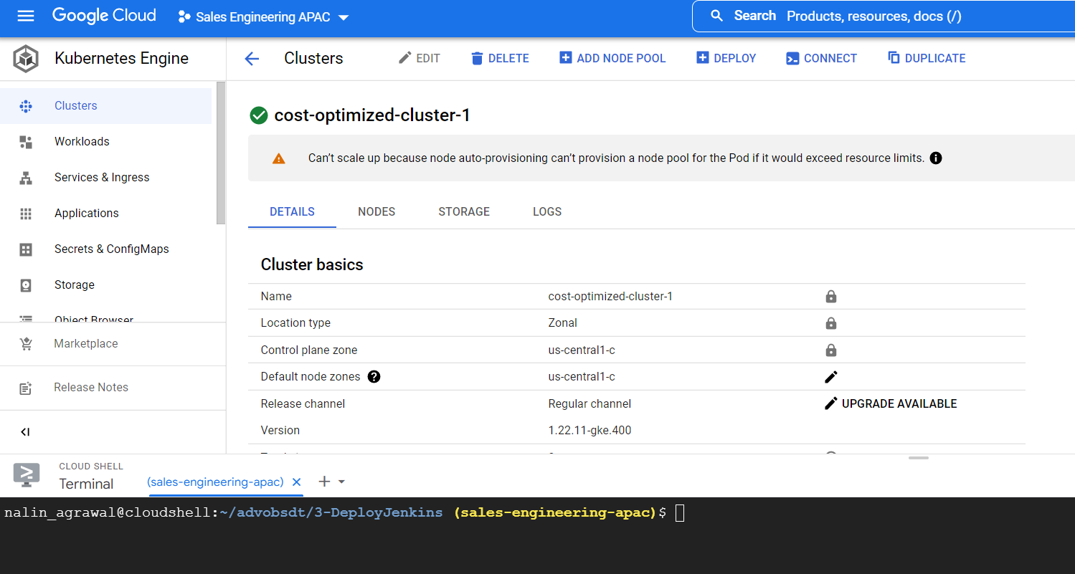
Configuring Cluster For Dynatrace Integration
Press Enter

Slide 13
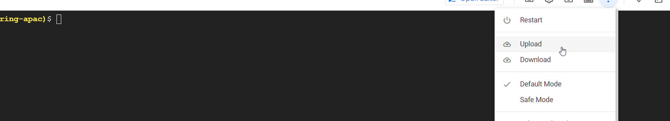
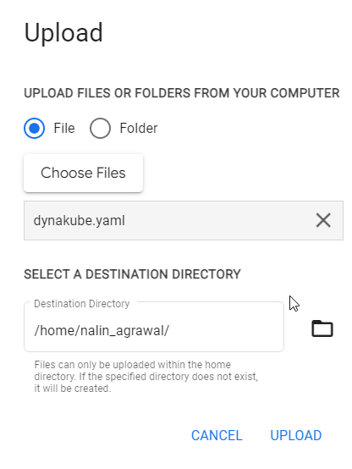
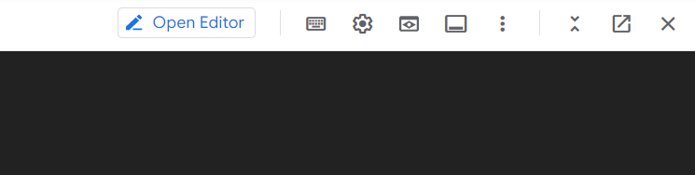
Configuring Cluster For Dynatrace Integration
Within Terminal Click Upload
Change to Editor VIew
Upload dynakube.yaml

Slide 14
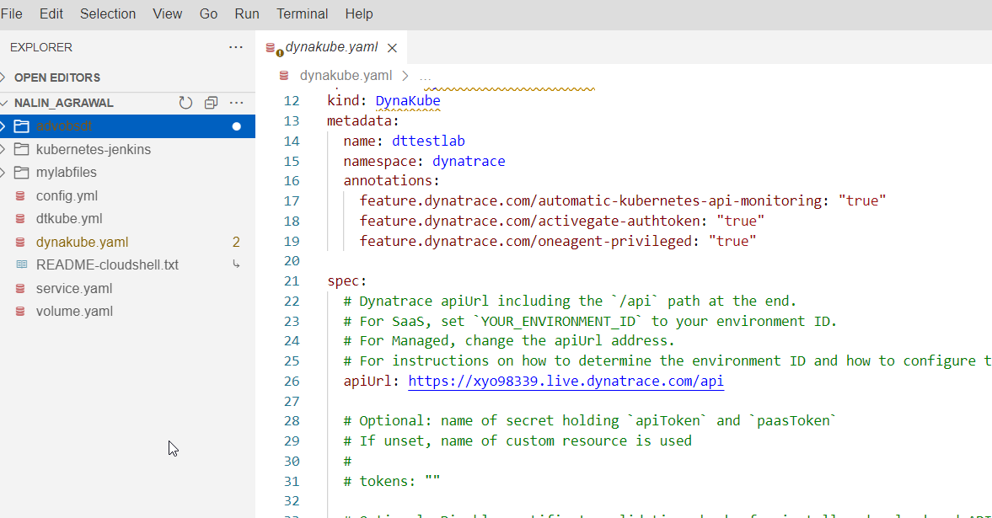
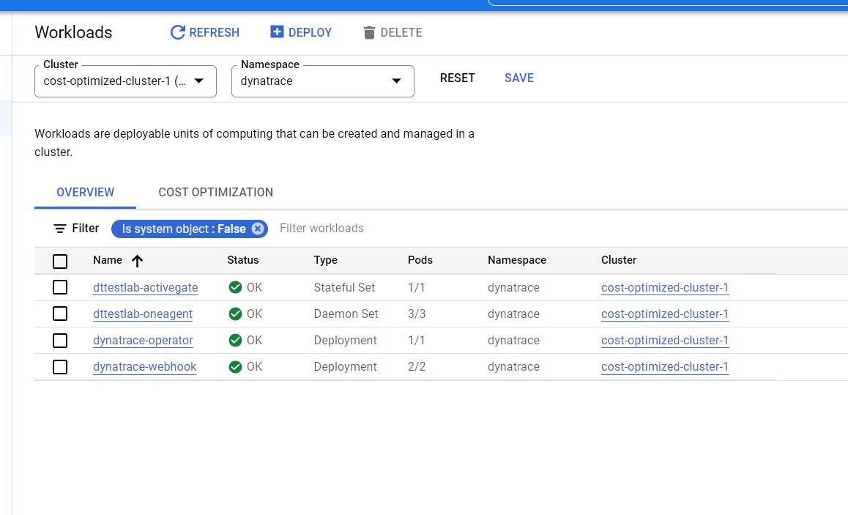
Configuring Cluster For Dynatrace Integration
Add the given line as shown on the screen
feature.dynatrace.com/oneagent-privileged: "true“
Execute command - kubectl apply -f dynakube.yaml
In the workloads view select namespace dynatrace and we should see given instances

Slide 15
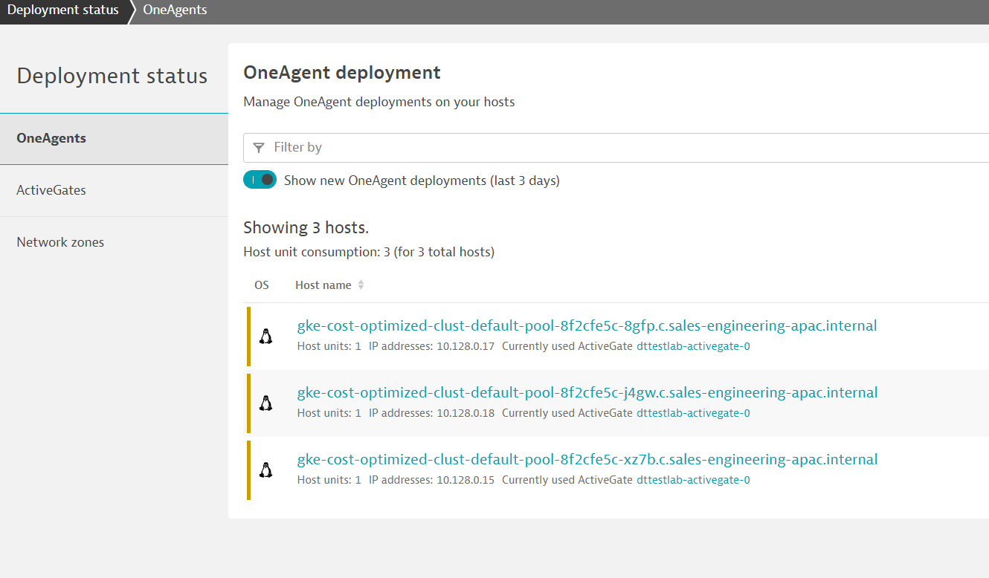
Verify In Dynatrace in Deployment Status

Slide 16
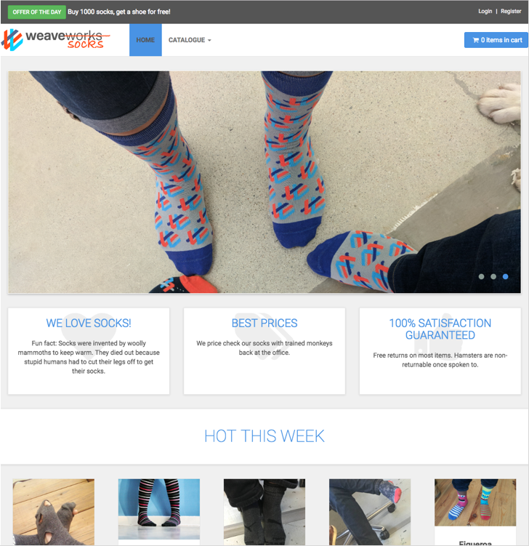
Sock Shop Application
Based on: http://socks.weave.works
Opensource microservice sample app
Polyglot
Java Spring Boot
Go
Node.js
RabbitMQ (order queuing)
MongoDB, MySQL (data stores)

Slide 17
Sock Shop architecture

Slide 18
Setup Sockhop – Cloning our repository
In Cloudshell, clone/download the following GitHub Repository:
https://github.com/nalinagrawaldt/advobsDT
This will create a folder called advobsDT
This will contain the scripts we will use for the remainder of the workshop

Slide 19
Dynatrace Credentials – Tenant ID & Environment ID
In order to proceed further we need to make note of our Dynatrace Tenant/Environment and API/PaaS Tokens
For the Tenant ID, you can find it in the first part of your URL
https://<TENANT_ID>.live.dynatrace.com – SaaS Deployments
For example, for https://jwx05250.live.dynatrace.com , Tenant ID=jwx05250

Slide 20
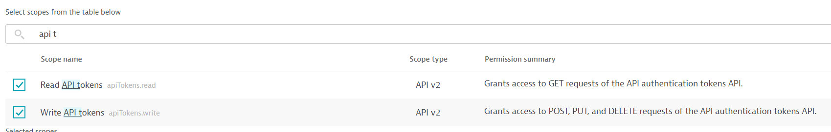
Dynatrace Credentials – API Token
Under Manage -> Access Token -> Generate Token
Click on Generate Token
Enter a name for your token (e.g. API Token
Select Expiration Date 10 Days from today
Template – None
Search Scope – Type – API Token
Select Read and Write API Token
Copy the token in a notepad (as this is only shown once)

Slide 21
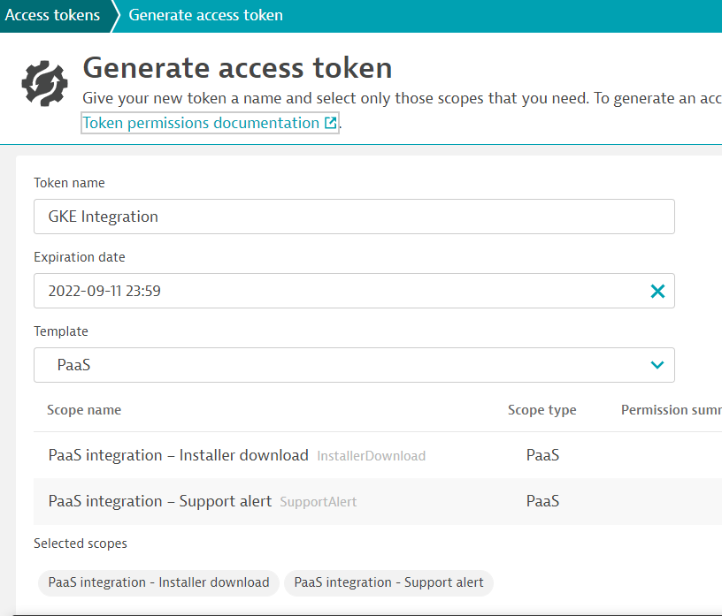
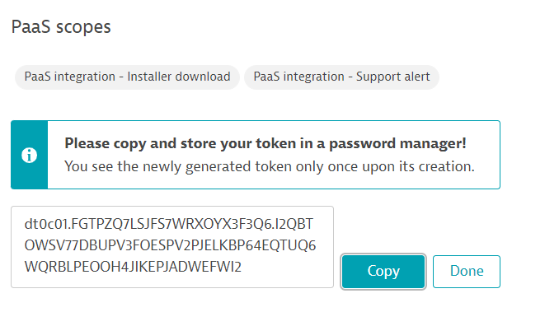
Dynatrace Credentials – Pass Token
Under Manage -> Access Token -> Generate New Token
Click on Generate Token
Enter a name for your token (e.g. GKE)
Give an expiration date
Don't forget to click on the Generate Token at the bottom of the page
Copy the token in a notepad (as this is only shown once)

Slide 22
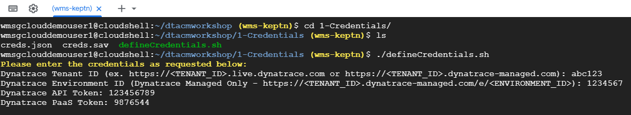
Creating our Credentials
We now need to store a local copy of our Dynatrace Tenant and API info for use when creating our cluster
Navigate to the directory 1-Credentials and execute the script defineCredentials.sh
This will ask for your Dynatrace Tenant/Environment information as well as your API and PaaS tokens
These values can be obtained from your Dynatrace tenant (see previous slides)
Once you have entered the values and confirmed they are correct, we can move on to creating our cluster

Slide 23
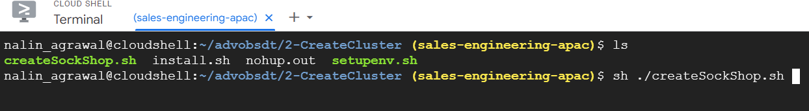
Setup our GKE Cluster
Back in your GCP account, launch a Cloudshell session
Navigate to the directory 2-CreateCluster
Execute createSockshop.sh
This step will take about 10 minutes to complete

Slide 24
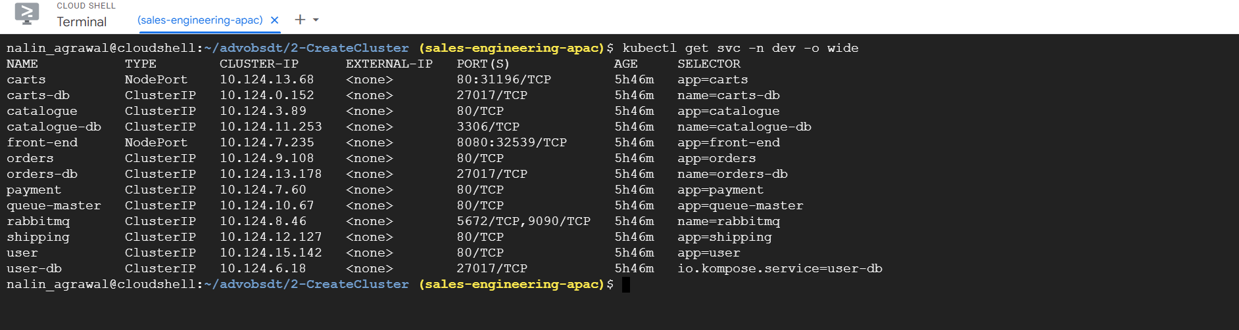
Validate our Cluster setup
After about 10 minutes since running the setupenv.sh script, let’s verify that everything is up and running
Let’s check and make sure our Deployments are Ready, run the following command in Cloudshell:
kubectl get svc –n dev -o wide
$kubectl get svc –n prod -o wide
Note: This can also be validated in the GKE Console by selecting “Workloads” from the menu on the left side of the screen

Slide 25
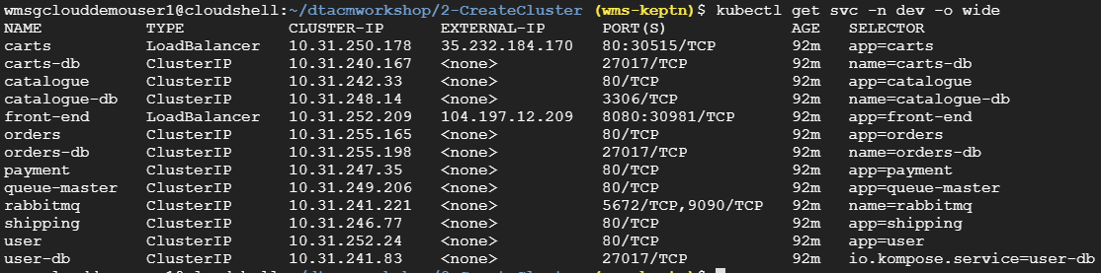
Validate our Cluster setup
Lets ensure that the SockShop application services are also created by running the following command:
$kubectl get svc –n dev -o wide
$kubectl get svc –n prod -o wide
Our Carts and Front-end services should have External-IP addresses assigned
Note: This can also be validated in the GKE Console by selecting “Services & Ingress” from the menu on the left side of the screen

Slide 26
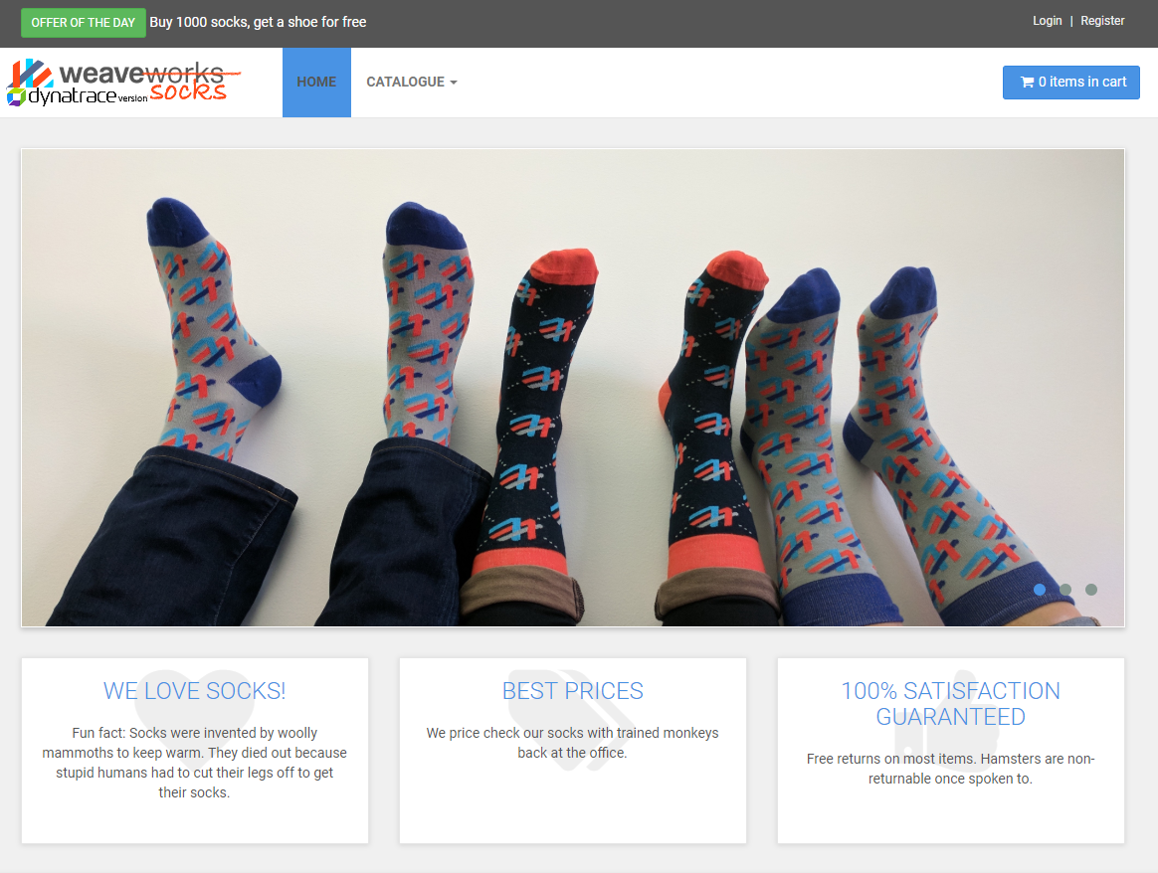
Validate our Cluster setup
Let’s launch our application in a web browser by copying and pasting the External-IP and Port of the front-end service. In the previous example it would be: http://104.198.138.49:8080
The SockShop homepage should appear in
your browser

Slide 27
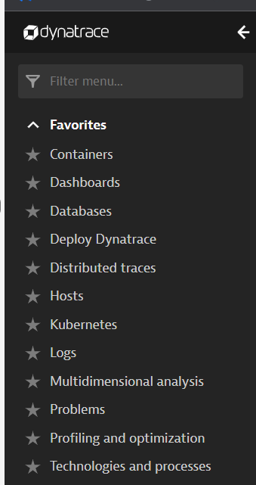
Verify Data in Dynatrace
Open the given dashboards in Dynatrace

Slide 28
To be continued

Slide 29
Clean up script placeholder
In Terminal/Cloudshell execute the script: cleanup.sh
This will remove the dev, production and istio-system namespaces (and their associated objects) so we have a clean cluster
After this completes, we will redeploy the sock shop application in the dev namespace. We only need to execute the script: deploy-sockshop.sh and then wait a few minutes
Then check if the SockShop app is back up and running
$kubectl get svc –n dev -o wide

Slide 30
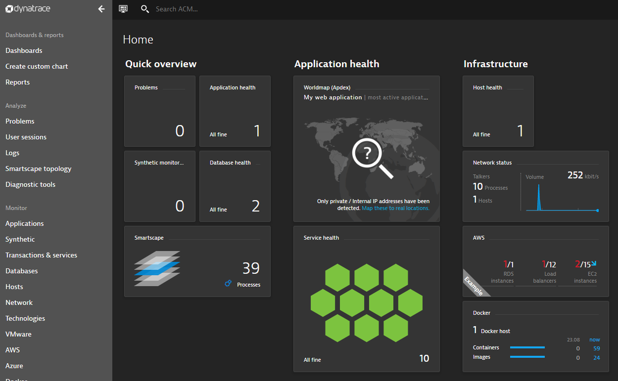
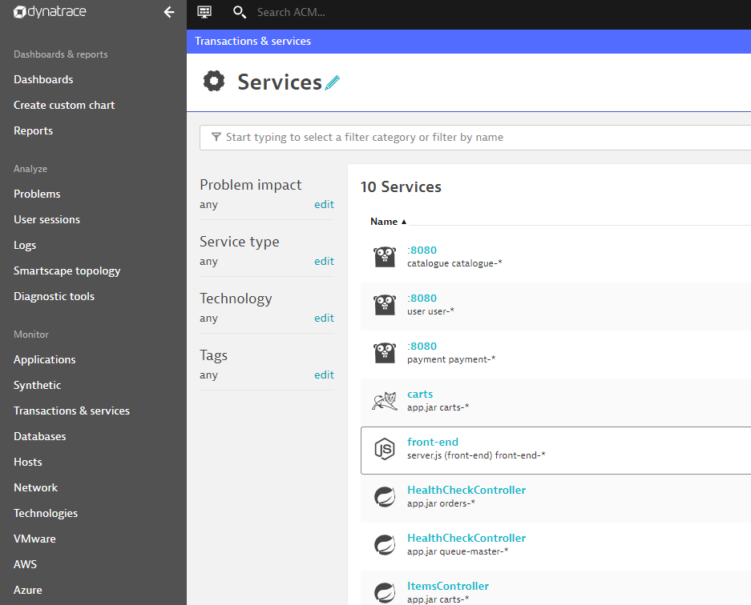
Validate Dynatrace
Now that we know our application is deployed and running successfully, we can validate that everything is being displayed in Dynatrace
Navigate back to Dynatrace and you should see data for Host, Process and Services

Slide 31
Deploying Jenkins

Slide 32
Jenkins
The Worlds most advanced BASH terminal
In most cases it’s fine to deploy to K8s via simple kubectl commands in k8s
Most of deployments probably done this way
Spoiler Alert: We’re going to be doing this today
No true “easy” way to determine a failure or if app is up and running
$kubectl wait –n dev deploy/myapp –-for condition=available
This won’t catch pods that didn’t actually come online

Slide 33
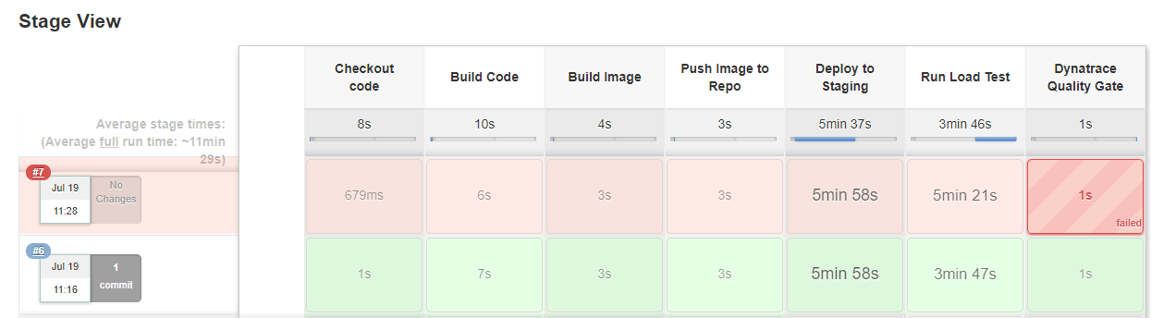
What our Pipeline will look like (hopefully)

Slide 34
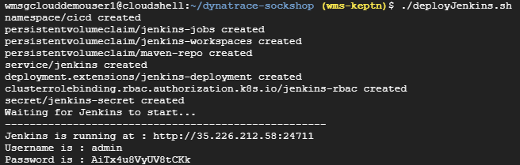
Deploy Jenkins
In Terminal/Cloudshell execute the script: deployJenkins.sh in the directory 3-DeployJenkins
This will deploy and startup Jenkins, import our pipeline and output the credentials
Note: You should change the default password!

Slide 35
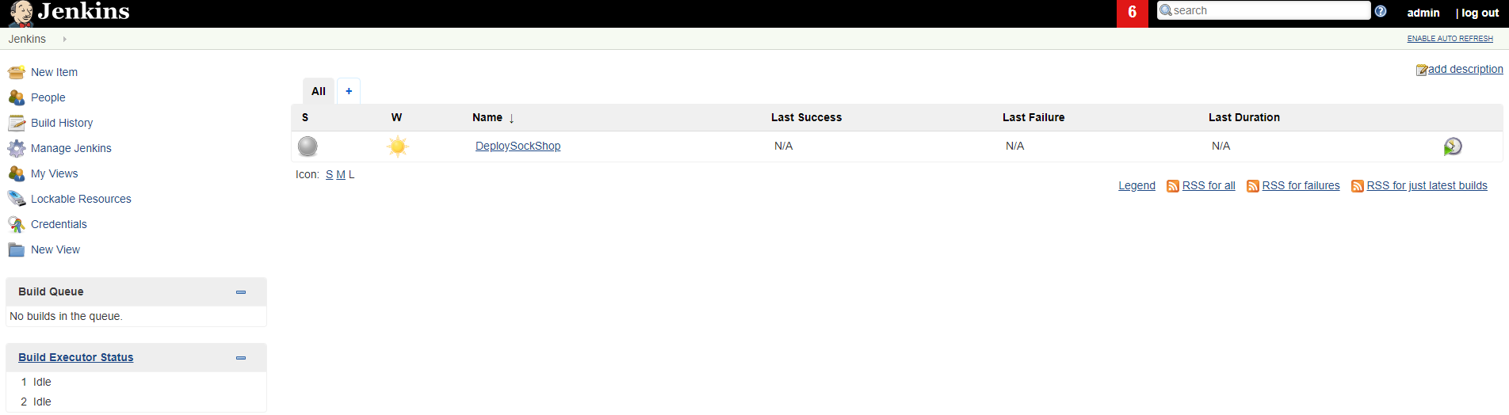
Jenkins Setup
After Jenkins has successfully deployed, navigate to the Jenkins URL and login with the previously provided username and password (again, recommend you change the password ☺

Slide 36
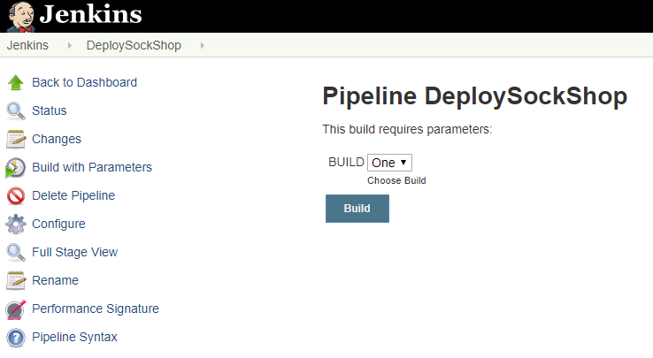
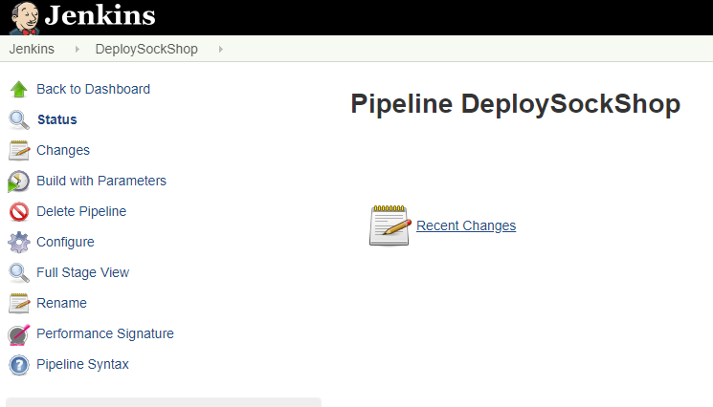
Run our first pipeline
On the Jenkins main screen we should see the “DeploySockShop” pipeline, select the pipeline by clicking it
Click Build with Parameters
Select Build “One” and Build

Slide 37
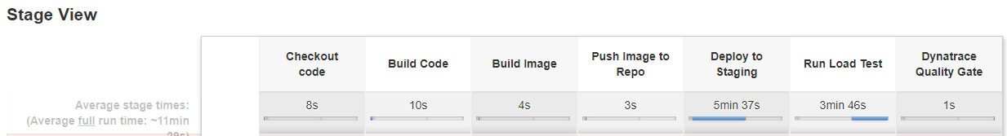
If all goes well…
The pipeline should run successfully (Note: this will take about 10 min)

Slide 38
Dynatrace Integration

Slide 39
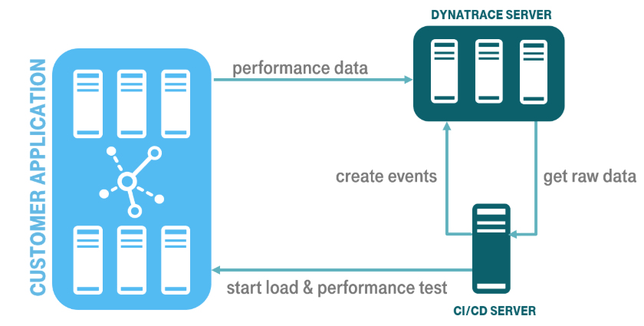
Dynatrace Integration
GitHub Repo and Example: https://github.com/jenkinsci/performance-signature-dynatrace-plugin/blob/master/README.md
Integration via the Dynatrace APIs (Timeseries and Events)
Based on a Performance Signature of a release (monspec)

Slide 40
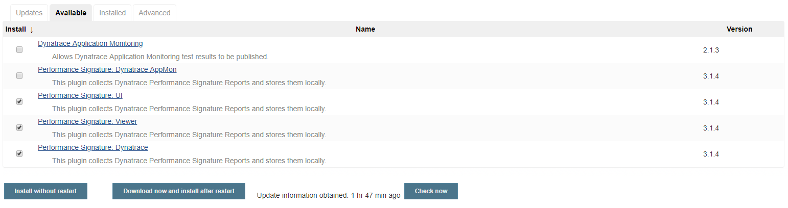
Install Jenkins Plugin
Navigate to Manage Jenkins -> Manage Plugins page and switch to the Available tab. Search for the "Dynatrace" keyword, select the 3 options below and click “Install without restart”.

Slide 41
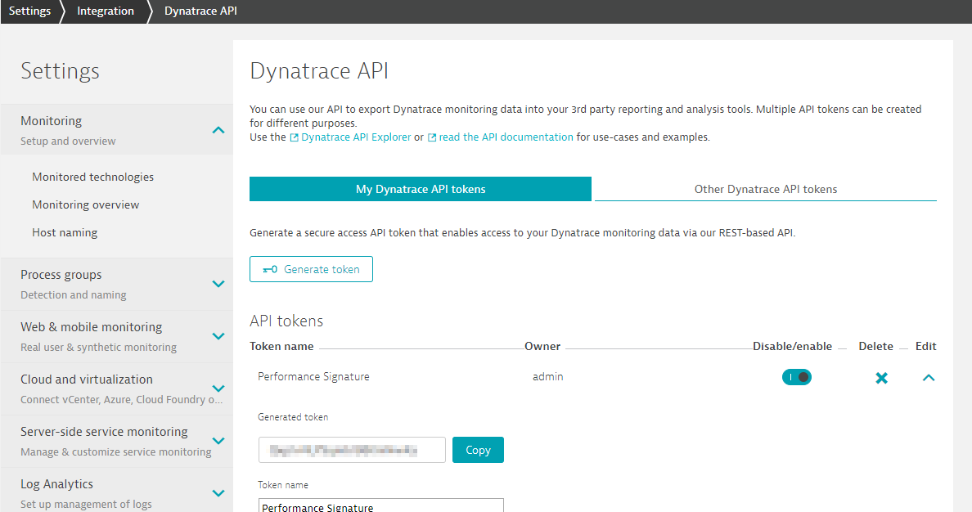
Dynatrace API
A Dynatrace API Token is needed for the Integration (Settings -> Integration -> Dynatrace API)
Only need the default top 3 permissions (This can be the same API Token as created in earlier steps)

Slide 42
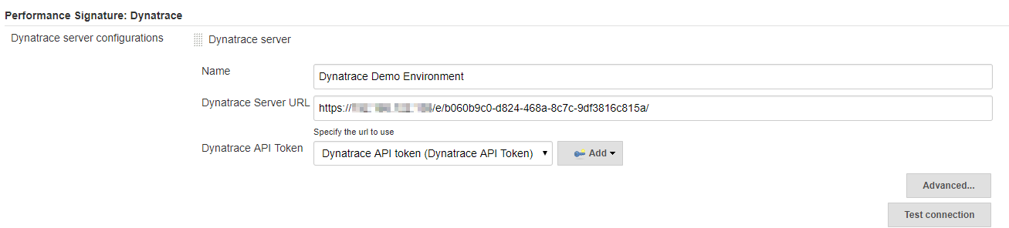
Jenkins Configuration
Navigate to Manage Jenkins -> Configure System -> Performance Signature: Dynatrace SaaS/Managed
Enter name of the
Server (ex. Dynatrace Server)
Your Tenant URL (https://xxxxxxxx.live.dynatrace.com) – SaaS, (https://asdfa.Dynatrace-managed.com/e/asdfafa) - Managed
API Token
Note: You many need to Save and exit this screen and come back for the “Add” dropdown to works, thanks to a bug in Jenkins
Test the Connection and Save

Slide 43
Adding Events to our Pipeline
There are three main events we will be adding to our Deployment Pipeline:
createDynatraceDeploymentEvent – Sends the Deployment Event to Dynatrace
recordDynatrace Session – Sets start/end time for when Perf Test beings
perfSigDynatraceReports – Queries all the metrics during the perf test timeframe and compares against the spec file. If metrics violate the spec file, the pipeline stage is failed

Slide 44
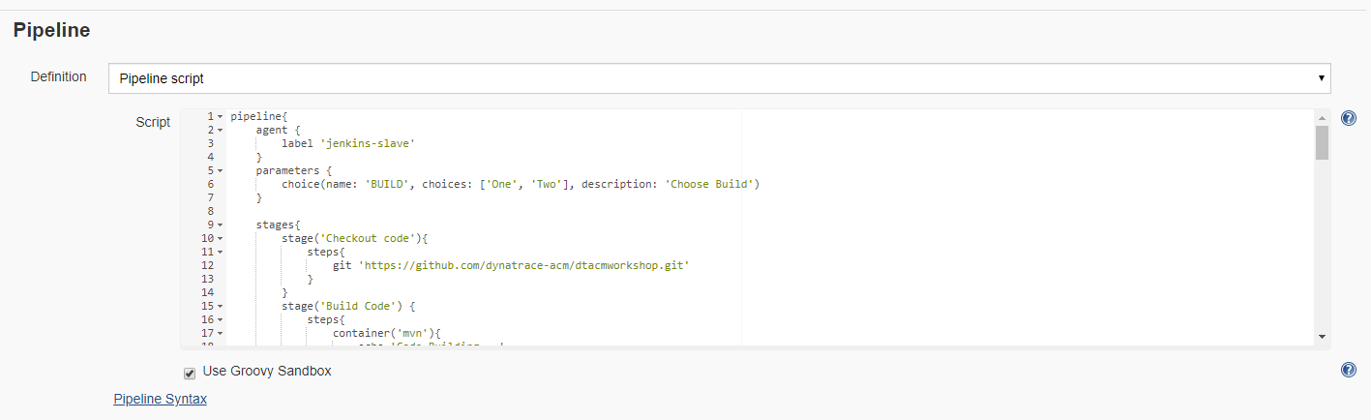
Adding Events to our Pipeline
In the DeploySockShop pipeline, click “Configure” and scroll down to the Pipeline script

Slide 45

Adding Events to our Pipeline – Deployment Events
First we want to add a Deployment Event to our Pipeline so every time we deploy our build to staging, Dynatrace will know about it

Slide 46

Adding Events to our Pipeline – Record Perf Test
Next we want to wrap our Loadtest stage with the recordDynatraceSession function, so we know when tests start and stop

Slide 47

Adding Events to our Pipeline – Compare results to monspec
After the load test is completed, we want to validate the test against our monspec file (see next slide), to determine if our build meets quality or not
Add the below stage (“Dynatrace Quality Gate”) to the very end of our pipeline

Slide 48
Sample Monspec File
{
"spec_version": "2.0",
"timeseries": [{
"timeseriesId": "com.dynatrace.builtin:service.responsetime",
"aggregation": "avg",
"tags": “[Kubernetes]app:carts,[Kubernetes]stage:dev",
"upperWarning": 1000,
"upperSevere": 3000
}
]
}

Slide 49
Adding Events to our Pipeline
Once the events are added to our Pipeline we can apply and save
Note: There is a sample Pipeline with the events already added in the root of the repository titled “PipelineWithIntegration.txt”
You can use this as a reference when editing your pipeline
Note: You will need to make sure you change the name of the Dynatrace Environment to the same thing as you named your connection earlier. This file uses the name “Dynatrace Server” as the Dynatrace Environment Name.

Slide 50
Let’s test our Integration

Slide 51

Deploy Build Two
After updating and saving our Pipeline to include the Dynatrace Performance Events, let’s re-run our pipeline with build Two
Select Build “Two” and Build

Slide 52

Now our build should fail

Slide 53
Deploy Ansible Tower
If we redeploy using Build #1, this build should pass our Dynatrace Quality Gate
Select Build “One” and Build

Slide 54
Auto-remediation with Ansible Tower

Slide 55



Ansible and Ansible Tower
Runbook – definition: a compilation of routine procedures and operations that the system operator (administrator) carries out
Ansible
Simple automation language + automation engine
Human readable (yaml)
Ansible Tower
Web UI
Management of runbooks
Powerful API for automation
Notes:
In a computer system or network, a runbook is a compilation of routine procedures and operations that the system administrator or operator carries out.
Ansible is an open source IT configuration management, deployment, and orchestration tool. Ansible uses YAML syntax for Ansible playbooks. YAML is used because it is very easy for humans to understand, read and write.
Ansible Tower is the web UI and dashboard for Ansible. It automates and presents tasks graphically, especially the monitoring and dashboard types of tasks.

Slide 56

Promotional campaign
We’ll be implementing a promotional campaign for our socks
This promotion will be randomly available to customers
The carts service has an endpoint allowing us to provide the percentage of users that will benefit from the promotional gift
The problem is that the promotion implementation is defective ☹
Nobody knows about it yet and this could potentially have disastrous effect on the brand and business reputation
Notes:
We’ll be implementing this use case with the carts service, since this feature is already implemented. The carts service includes the endpoint carts/1/items/promotional/ that can take a numeric input value, the percentages of user interactions that will receive the promotional gift. For example, say 5% of users.
Therefore, we can easily change the behavior of our carts service at runtime. However, changing the value without using a configuration management system would not allow us to track when changes happened and which configuration values have changed. So, that’s why we are using Ansible Tower to execute changes in our configuration.

Slide 57



Runbook automation workflow
Trigger promotional campaign
with Promotion Rate set to 50 %
Set Promotion Rate to 50 %
Send custom configuration event
Monitors Sockshop & detects
increase of failure rate
Sends problem notification
Set Promotion Rate to 0 %
Send custom configuration event
Send comment to problem
Notes:
We’ll be implementing this use case with the carts service, since this feature is already implemented. The carts service includes the endpoint carts/1/items/promotional/ that can take a numeric input value, the percentages of user interactions that will receive the promotional gift. For example, say 50% of users.
Therefore, we can easily change the behavior of our carts service at runtime. However, changing the value without using a configuration management system would not allow us to track when changes happened and which configuration values have changed. So, that’s why we are using Ansible Tower to execute changes in our configuration.

Slide 58

Deploy Ansible Tower
In Terminal/Cloudshell execute the script: deployTower.sh in the directory 4-DeployTower
This will deploy and startup Ansible Tower. This will also configure Tower, import projects, inventories, credentials (DT API token) and playbook templates.
Take a note of the Ansible Job URL displayed by the script. You will need it for a next step.

Slide 59

Log in the Ansible Tower console
Use the job template URL you copied earlier, without the path, and copy it in your browser to load the Ansible Tower console
For example, if the job template URL was : https://34.69.184.20/#/templates/job_template/35
then the console URL is : https://34.69.184.20
You will be prompted to provide a license file and accept the license agreement
If you don’t already have your license file, click the button to request a free trial license from Red Hat (delivered via email)
Log in Ansible Tower
username : admin
password : dynatrace

Slide 60

Configure Dynatrace Problem Notification
In the Dynatrace UI, navigate to Settings -> Integration -> Problem Notification -> Ansible Tower

Slide 61


Configure Ansible Tower integration
Enter the Ansible Tower job template URL you were provided after the deployment
Enter the credentials to access Ansible
username : admin
password : Dynatrace
Click the Sent test notification button to validate your configuration
on success, a green confirmation message will be displayed
Save your configuration

Slide 62

Adjust Anomaly Detection
Both problem and anomaly detection in Dynatrace leverage AI technology. This means that the AI learns how each and every microservice behaves and baselines them. Therefore, in a demo scenario like we have right now, we have to override the AI engine with user-defined values to allow the creation of problems due to an artificial increase of a failure rate. (Please note: if we would have the application running and simulate end-user traffic for a couple of hours/days there would be no need for this step.)
In your Dynatrace tenant, navigate to “Transaction & services” and filter by: [Kubernetes]app:carts and [Kubernetes]environment:production

Slide 63

Adjust Anomaly Detection (Cont.)
Click on the ItemsController and then on the three dots ( … ) next to the service name. Click on Edit

Slide 64

Adjust Anomaly Detection (Cont.)
On the next screen, edit the anomaly detection settings as seen in the following screenshot. - Global anomaly detection has to be turned off - Detect increases in failure rate using fixed thresholds - Alert if 0 % custom failure rate threshold is exceed during any 5-minute period. - Sensitivity: High

Slide 65


Launch Campaign playbook
Navigate back to the Ansible Tower UI
From the side menu, navigate to Resources -> Templates
Click on the rocket icon to launch the start-campaign playbook
Hit Next on the prompt popup window and then Launch
As the playbook runs, the output will be displayed. Validate that the recap shows OK=2

Slide 66

Observe the promotional campaign
In the Dynatrace console, navigate to Transactions & Services and drill-down into the production ItemsController service
Tip : filter by tag : [Kubernetes]stage:prod to only display services in production

Slide 67

Observe the promotional campaign
Look at the Service events.
The Start Campaign playbook have notified Dynatrace when the promotional rate was changed to 50%

Slide 68


Observe the promotional campaign
You should see the Failure Rate increasing, eventually leading to Dynatrace detecting a Problem
You might need to refresh your browser a few times

Slide 69

Observe the auto-remediation playbook actions
Go back to the Service view
The comments section will show the remediation actions taken by Ansible Tower

Slide 70

Observe the auto-remediation playbook actions
Drill-down in the Problem.
You will see a new configuration change event reported by Ansible Tower
The promotional rate has been set back to 0% to remediate to the transaction failures

Slide 71

Observe the auto-remediation playbook actions
Jobs executed in Ansible Tower
start-campaign (set rate to 50%)
remediation
push comment to Dynatrace Problem
retrieve problem details
launch remediation action related to problem context
update Dynatrace Problem
stop-campaign (set rate to 0%)

Slide 72

That’s it! Problem solved automatically
Look at the Service Failure Rate. It has returned to 0%

Slide 73
Runbook automation workflow recap
Trigger promotional campaign
with Promotion Rate set to 50 %
Set Promotion Rate to 50 %
Send custom configuration event
Monitors Sockshop & detects
increase of failure rate
Sends problem notification
Set Promotion Rate to 0 %
Send custom configuration event
Send comment to problem

Slide 74
Clean up

Slide 75
Clean up
If you want to keep the cluster running but:
remove Jenkins : execute the script removeJenkins.sh contained in the utils directory
remove Ansible Tower : execute the script removeTower.sh container in the utils directory
If you want to delete everything, feel free to delete the GKE cluster via the GKE Console

